Slide 1

ARRAYS IN JAVA SCRIPT
Sai Vardhan T

Slide 2
ARRAYS
JavaScript arrays are a fundamental data structure used to store multiple values in a single variable.
They are a type of object used for storing multiple values in a single variable.
Each value in an array is called an element, and each element can be accessed by its index.
Arrays in JavaScript can hold elements of any data type, including strings, numbers, objects, and even other arrays.

Slide 3

CREATING ARRAYS
You can create an array in JavaScript using either literal notation or the Array constructor.
Literal Notation:
Using “Array” Constructor:

Slide 4
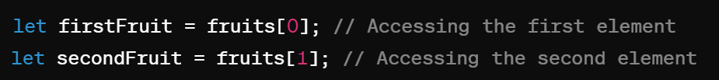
ACCESSING ELEMENTS
We can access elements of an array using their index
JavaScript arrays are Zero-indexed, meaning the index of the first element is 0.

Slide 5
MODIFYING ELEMENTS
We can modify elements of an array by assigning a new value to the specific index.

Slide 6
ARRAY METHODS
JavaScript provides a variety of built-in methods for working with arrays
Push()
Pop()
Shift()
Unshift()
Slice()
Concat()
Join()
Indexof()
forEach()
Map()
Filter()
Reduce()

Slide 7
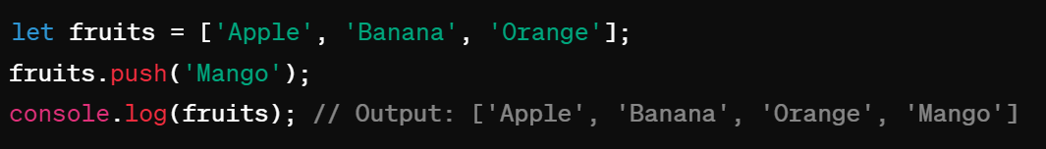
PUSH()
Adds one or more elements to the end of an array and returns the new length of the array.

Slide 8
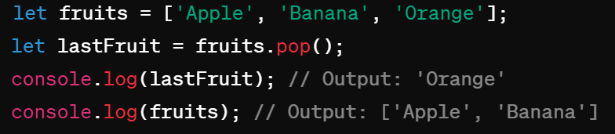
POP()
Removes the last element from an array and returns that element.

Slide 9
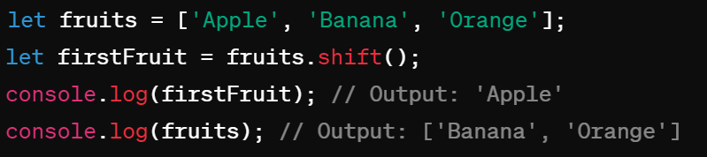
SHIFT()
Removes the first element from an array and returns that element, shifting all subsequent elements to a lower index.

Slide 10
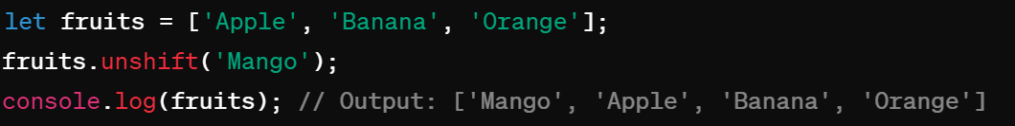
UNSHIFT()
Adds one or more elements to the beginning of an array and returns the new length of the array.

Slide 11
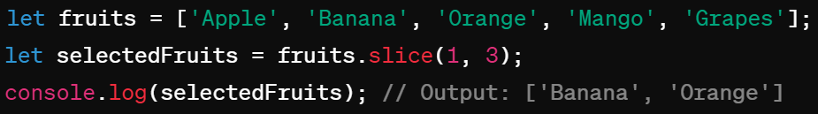
SLICE()
Returns a shallow copy of a portion of an array into a new array object selected from start to end(end not included)

Slide 12
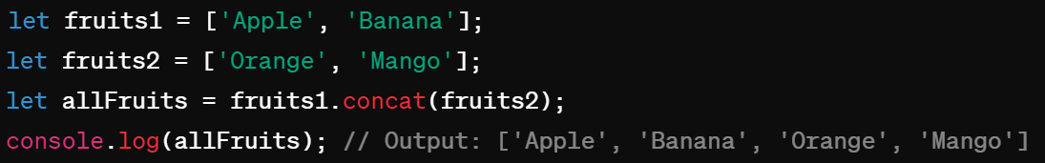
CONCAT()
Returns a new array comprised of the array joined with other arrays(s) and/or value(s)

Slide 13
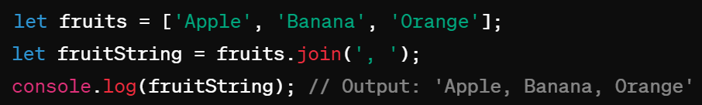
JOIN()
Joins all elements of an array into a string.

Slide 14
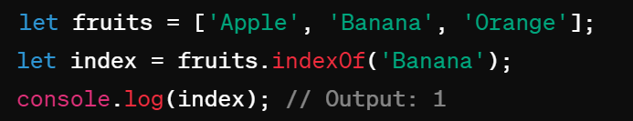
indexOf()
Returns the first index at which a given element can be found in the array or -1 if it is not present

Slide 15
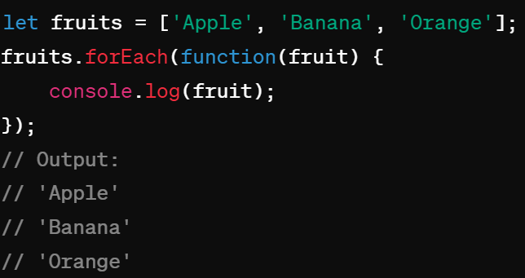
forEach()
Executes a provided function once for each array element

Slide 16
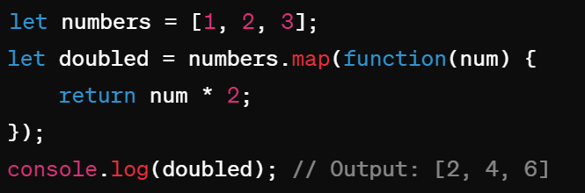
Map()
Creates a new array populated with the results of calling a provided function on every element in the calling array.

Slide 17
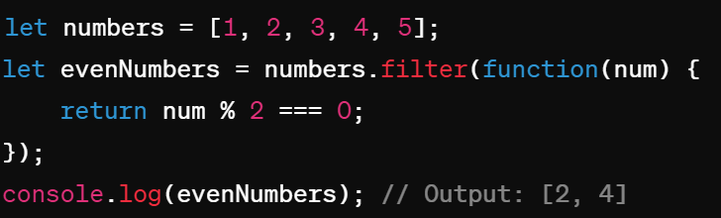
Filter()
Creates a new array with all elements that pass the test implemented by the provided function.

Slide 18
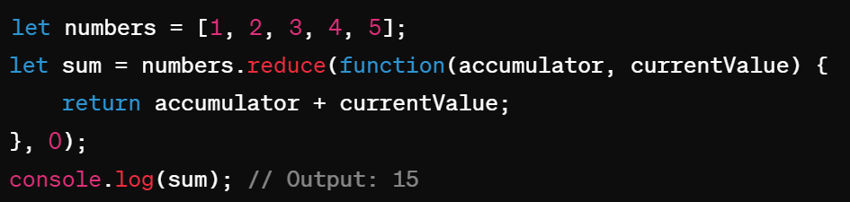
Reduce()
Applies a function against an accumulator and each element in the array (from left to right ) to reduce it to a single value.

